Slide 1
Overview of Opioid Settlement Funds and a Brainstorming Approach for Determining the Use of Funds in Juneau

Slide 2
Objectives
Review:
City and Borough of Juneau Priorities and Plans
Amount of J&J Settlement Funds Coming to Juneau
National and Alaska Overdose Prevention Strategies
Examples of Opioid Remediation Provided in Settlement
Protective & Risk Factors in Youth
Applying Upstream Prevention, Treatment, Harm Reduction and Recovery to Juneau
John’s Hopkins Guiding Principals for the Use of the Funds and Governor’s Advisory Council on Opioid Remediation Recommendations
Opportunities and Resources Engagement between City and Borough and Community
Next Steps
Resources

Slide 3
City and Borough of Juneau Priorities and Plans
What discussions have already happened?
Are there already ideas already floating around for the use of the funds?
What are CBJ’s priorities?
Does CBJ wish to engage with the public for suggestions?

Slide 4
How much J&J settlement money is coming to Juneau?
  $459,666/18 years
  Note: Due to signing the agreement early, the first 5 payments from J&J were already deposited along with the annual distributor payments. There is currently $XX in an account.
Next Steps to Consider: Evaluate current and potential sources of local, state and federal funding and consider how they could be braided/used for match for more impact.

Slide 5
Frameworks for Addressing the Opioid Epidemic

Slide 6
U.S. Health and Human Services Overdose Prevention Strategy
Upstream/ Primary Prevention | This strategy promotes tiered, multidisciplinary prevention activities, ranging from population-level strategies to targeted interventions aimed at high-risk individuals. These activities engage health and human services providers directly and facilitate cross-sector collaboration on prevention. Click to read more.
Treatment | Evidence-based and culturally-relevant treatments for substance use disorder can reduce substance use, related health harms (for example, infectious disease transmission), and overdose deaths. High-quality treatment can also increase social functioning. This strategy focuses on reducing barriers to accessing the most effective treatments, using motivational and cultural enhancements to encourage those who might be reluctant, advancing strategies to improve engagement and retention, and continuing to develop new therapeutic approaches. Click to read more.
Harm Reduction | Individuals inherently deserve services that promote health, regardless of whether they use drugs. Evidence-based and culturally-relevant harm reduction strategies minimize negative consequences of drug use. These activities further expand access to harm reduction interventions and better integrate harm reduction into general medical care. Click to read more.
Recovery | This strategy recognizes that treatment alone may not be enough to support long-term recovery. Despite the demonstrated benefits of recovery support services -- such as peer supports, employment and housing services -- various challenges impede their availability and uptake. Enhancing coverage and integration of recovery support services is critical to promoting access to and use of these services. Strengthening the recovery support services workforce is also essential to promoting access and quality. Click to read more.

Slide 7
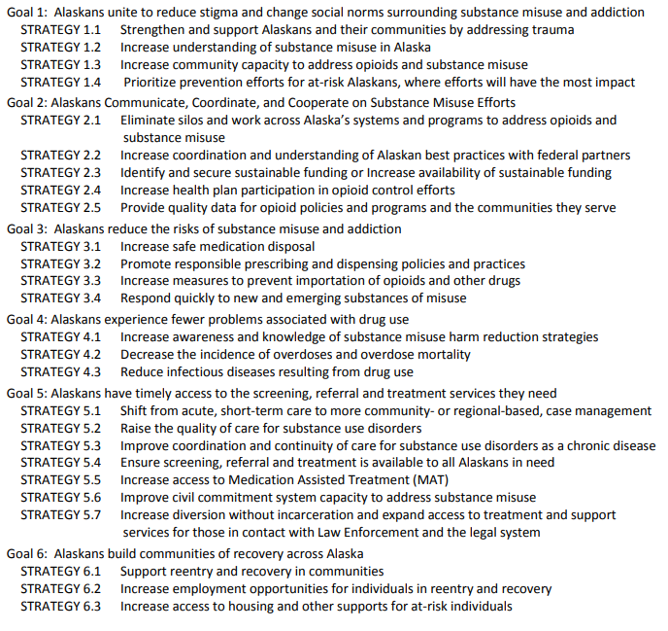
Alaska Statewide Opioid Action Plan 2018-2022
Click here for link to plan.

Slide 8
Examples of Opioid Abatement and Remediation
Schedule A Core Strategies listed. Refer to page 116, Exhibit E of settlement document for more examples.
Upstream/ Primary Prevention | Evidence-Based and/or Culturally Relevant Prevention Programs in Schools Community Drug Disposal Programs Media Campaigns to Prevent Opioid Use Disorder
Treatment | Targeted Screening Targeted Distribution of Medications for Addiction Treatment and Integration Across Continuum of Care Wraparound Services for People w/Opioid Use Disorder Services for Babies w/Neonatal Abstinence Syndrome and Caregiver Treatment for Women with Opioid Use Disorder and Co-Occurring Substance Use and Mental Health Disorders Twelve-Months Postpartum
Harm Reduction | Targeted Naloxone Distribution Syringe Exchange and Wrap Around Services Including Linkage to Opioid Use Disorder Treatment Access to Sterile Syringes and Linkage to Care and Treatment of Infectious Diseases
Recovery | Wraparound Services and Housing for Opioid Use Disorder and Co-Occurring Substance Use and Mental Health Disorders
Training/Outreach | Best Prescribing Practices Medications for Addiction Treatment Naloxone Administration Pre-Arrest Diversion and Post-Overdose Response for First Responders
Research and Development | Evaluate data infrastructure needs to support measuring progress of opioid abatement strategies (Use outcome-based measures that reflect intent of opioid abatement and internal processed-based measures to ensure transparency and effective management)

Slide 9
Protective & Risk Factors

Slide 10
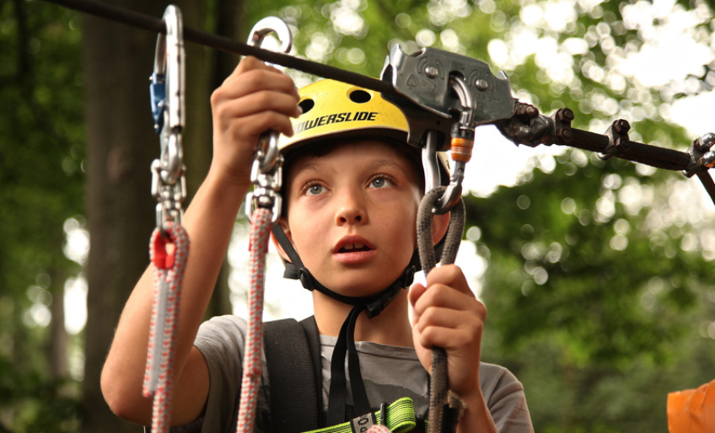

Protective Factors: What Are They?
Examples of protective factors that support social and emotional development for youth in afterschool programs include:
Feeling connected
Experiencing a caring climate
Participating in the program itself
Receiving early intervention services
Connectedness in afterschool programs is described in four primary ways:
Being treated fairly by adults
Feeling close to other youth in the program
Feeling emotionally and physically safe
Feeling like a part of the program
Strengthening Families™
The five protective factors associated in research that are related to the prevention of child maltreatment are:
For adults:
Parental resilience
Social connections
Knowledge of parenting and child development
Concrete support in times of need
For children:
Healthy social and emotional development
Source: http://dhss.alaska.gov/ocs/Pages/families/default.aspx
Characteristics within the individual-or conditions in the family, school, or community-that help a person cope successfully with life challenges.
When people can successfully cope with their problems and deal with preexisting risk factors, they are less likely to engage in risky behavior.
Interested in more like this? See Christina Bethell’s 2019 article on “Positive Childhood Experiences”
https://jamanetwork.com/journals/jamapediatrics/fullarticle/2749336
Notes:
JENNY
Jessica will get into a more in depth discussion of the connection between substance use and child maltreatment.
IF THERE IS ANYTHING YOU TAKE AWAY TODAY, TAKE AWAY THAT WE HAVE TO FORM RELATIONSHIPS AND CONNECTEDNESS TO ONE ANOTHER AND OUR COMMUNITIES. CHURCHES ETC.
PUT DOWN THE SMARTPHONE. Nov 4, 2019 John S. Hutton JAMA Pediatrics 47 3-5 year olds underdeveloped
Kids who learn about the risks of drugs at home are significantly less likely to use drugs than those who don’t. You should encourage parents to learn about substances and talk about them with their teens. One of the biggest reasons youth give for not using drugs is that they don’t want to disappoint their parents. Because you sometimes fill the role of a student’s parent-as another caring adult in their lives-these tips are good suggestions for teachers and other school staff.
Teachers, staff, and parents should talk with young people about their views on drugs, especially why it is important to avoid all recreational drugs. This is a conversation that should take place early in the teenage years, on multiple occasions. You can discuss scenes from media, such as television, music, or movies, that show drug use. This can help you touch base with teens about their current views or questions about drugs. Focus on their future goals, and how substance misuse can get in the way of attaining those goals. Establish yourself as a resource. If students know they can count on you for answers to their questions, they will come back for more information. When your students talk, listen to their answers.

Slide 11

Knowledge as a Protective Factor for Preventing Opioid Overdose
Avoid mixing pain medicines with alcohol, sleeping pills, or any illicit substance.
Only take medication prescribed by doctor and ask doctor for alternatives to opioids, and for the minimal amount of pills.
Recognize signs of misuse and overdose and how to use naloxone, and teach others how to as well.
Keep up-to-date on facts about drugs and alcohol as well as the available resources in community.
Teach parents/caregivers about safe storage of all medications and disposing unused medication using drug take-back programs or drug deactivation disposal bags.
Teach youth about brain development and its connection to a greater risk for developing an addiction to substances.
Encourage youth to delay or abstain from substance use.
Overdose
Notes:
JENNY
Upstream Prevention
Four out of five heroin users report using opioid pain relievers non-medically prior to using heroin (Jones CM 2013). Their access to this nonmedical use was characterized by three main sources:
• Family
• Friends,
• Personal prescriptions

Slide 12
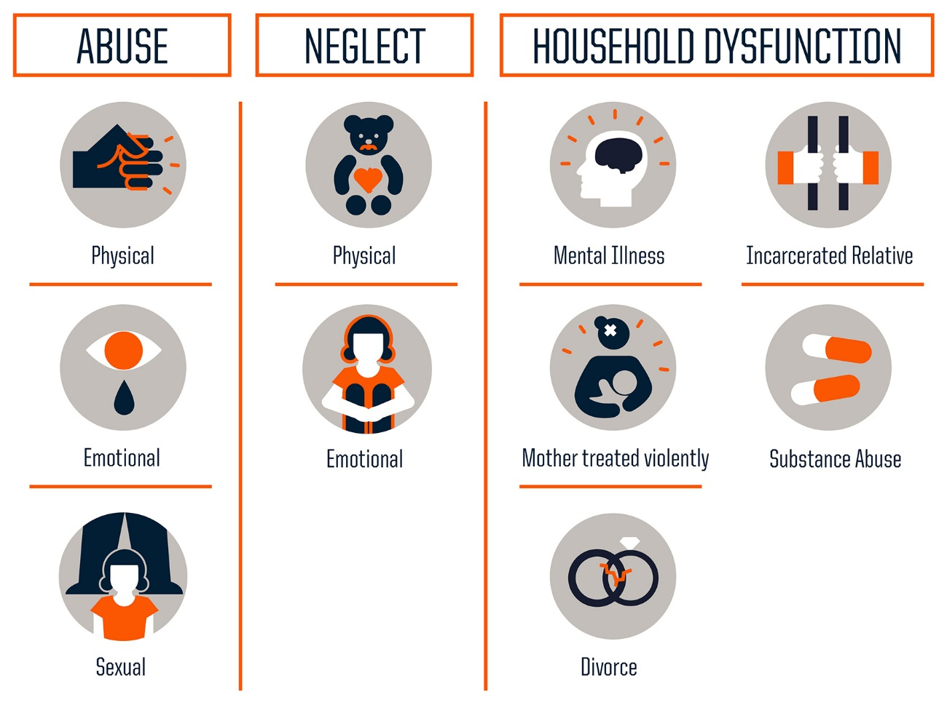
Risk Factors: What we know
World Health Organization (WHO) and Healthy People 20/20 define Social Determinants of Health as the conditions in “which people are born, grow, work, live, and age, and the wider set of forces and systems shaping the conditions of daily life.”
The five identified key determinants are:
Economic stability
Education
Social and community context
Health and health care
Neighborhood and built environment
“We know that a child’s life expectancy is predicted more by his ZIP code than his genetic code.”
(Dr Risa Lavizzo-Mourey, President of the Robert Wood Johnson Foundation)
Risk factors related to school-aged youth include:
Not doing well in school
Dropping out of school before age 15
Loss of cultural identity and connection
Friends who engage in problem behaviors
These can lead to risky behaviors including:
Use of alcohol, tobacco, and other drugs
Violence
Suicidal ideation
Early sexual activity
Some risk factors make people particularly vulnerable to opioid misuse and overdose, including:
Obtaining overlapping prescriptions from multiple providers
Taking high daily dosages
Having mental health problems
Living in rural areas
Having low income
Having a history of alcohol or substance misuse
Risk factors are characteristics within an individual-or conditions in the family, school, or community-that increase the likelihood that the person will engage in risky behavior.
The more risk factors that are present in a young person’s life, the greater the likelihood that problems will develop during adolescence.
Adverse Childhood Experiences (ACEs)
Social Determinants of Health
Graphic Credit: Robert Wood Johnson Foundation
Notes:
JENNY
Exposure to stress (such as emotional or physical abuse) in childhood primes the brain to be sensitive to stress and seek relief from it throughout life; this greatly increases the likelihood of subsequent drug abuse and of starting drug use early. (NIH Principles of Adolescent Substance Use Disorder Treatment: A Research-Based Guide)
Chronic Stress = Depleted Endorphins and a smaller less protected Hippocampus (shot of morphine reduces PTSD)

Slide 13
Applying the framework to Juneau

Slide 14
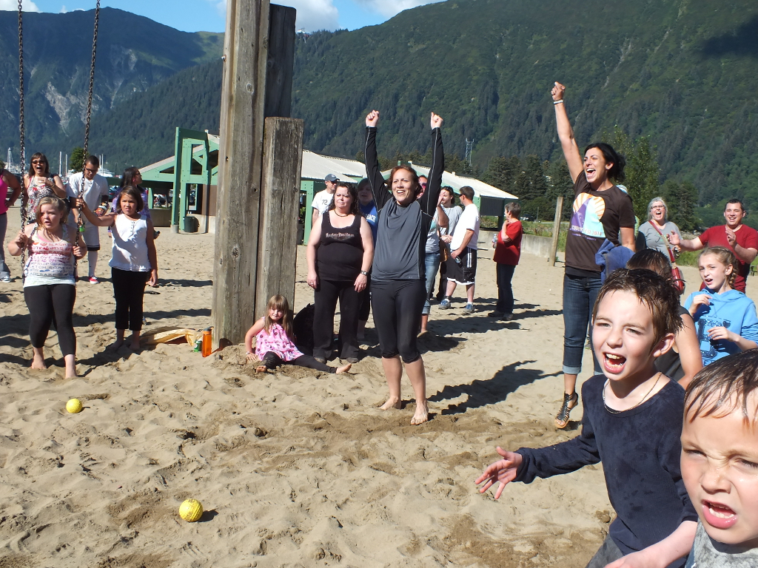
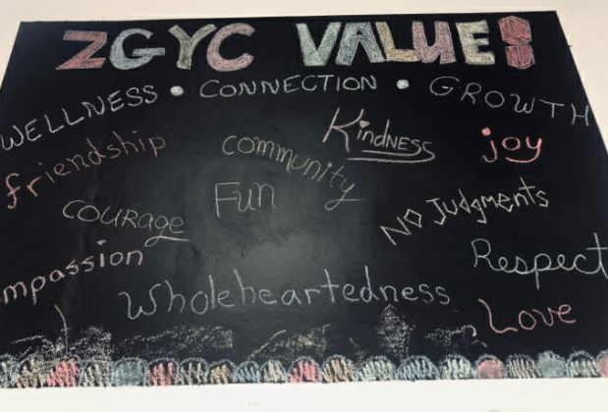
Some examples: Family promise, AEYC, Big Brothers/Big Sisters, sports, clubs, creating protective factors for youth, education in school district
Upstream/Primary Prevention in Juneau
Next Steps to Consider: What does upstream/primary prevention look like in Juneau? What is going great and could be made even better with more financial support? What is missing?

Slide 15
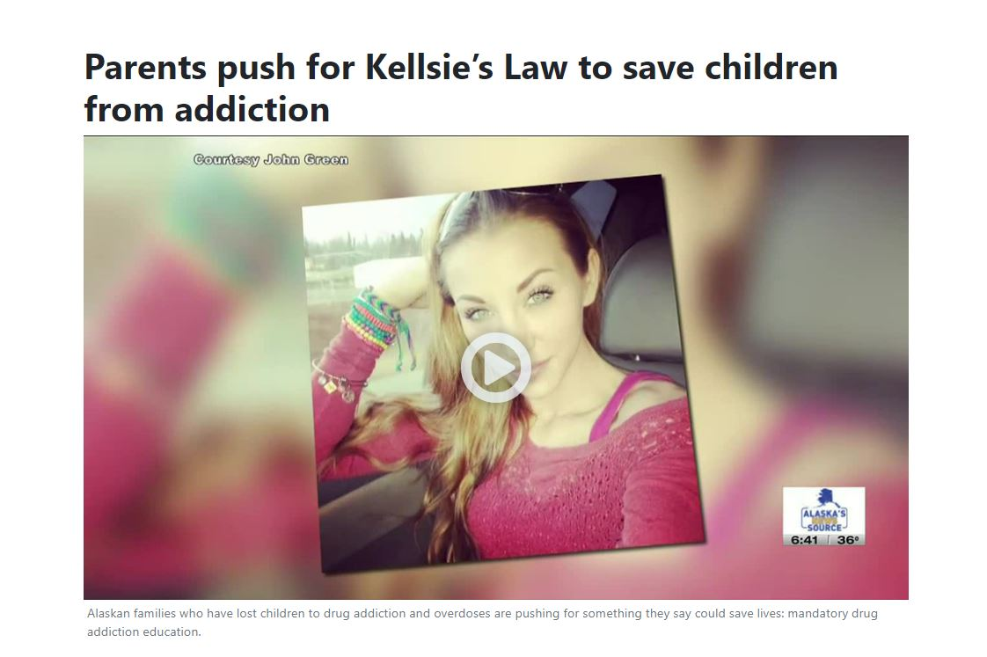

Slide 16
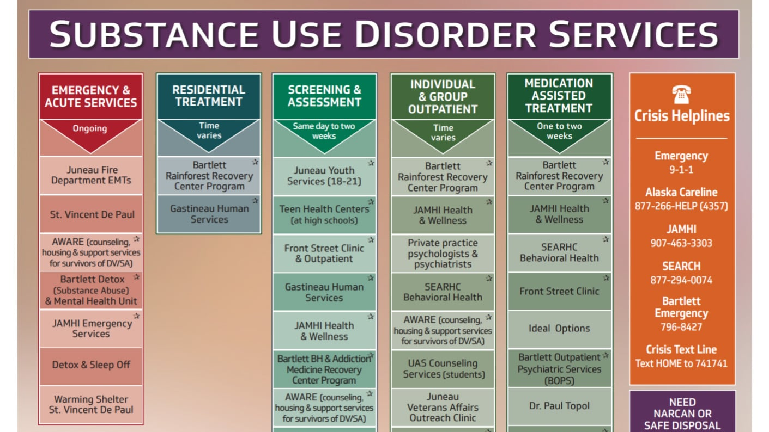
Treatment in Juneau
Next Steps to Consider: What Treatment Services exist in Juneau? What is going great and could be made even better with more financial support? What is missing?

Slide 17
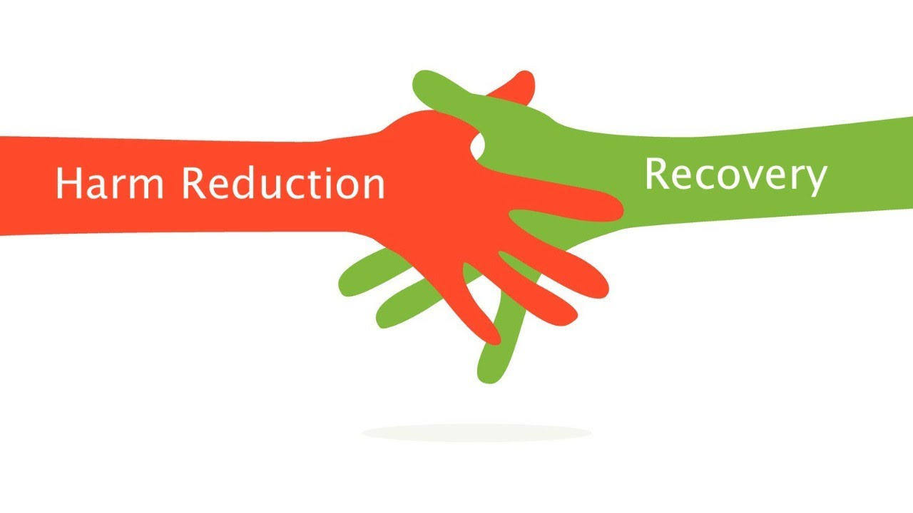
Harm Reduction in Juneau
Naloxone available in multiple locations: Front Street, JAMHI, Bartlett, Juneau Public Health, GHS, Midtown Clinic, Tlingit and Haida
Four As Syringe Exchange, DATA from 2023:
137 unique participants, with 31 intakes
42,431 syringes provided (from January 2023– today)
8,619 syringes returned (from January 2023-today)
Next Steps to Consider: What Harm Reduction Services exist in Juneau? What is going great and could be made even better with more financial support? What is missing?

Slide 18
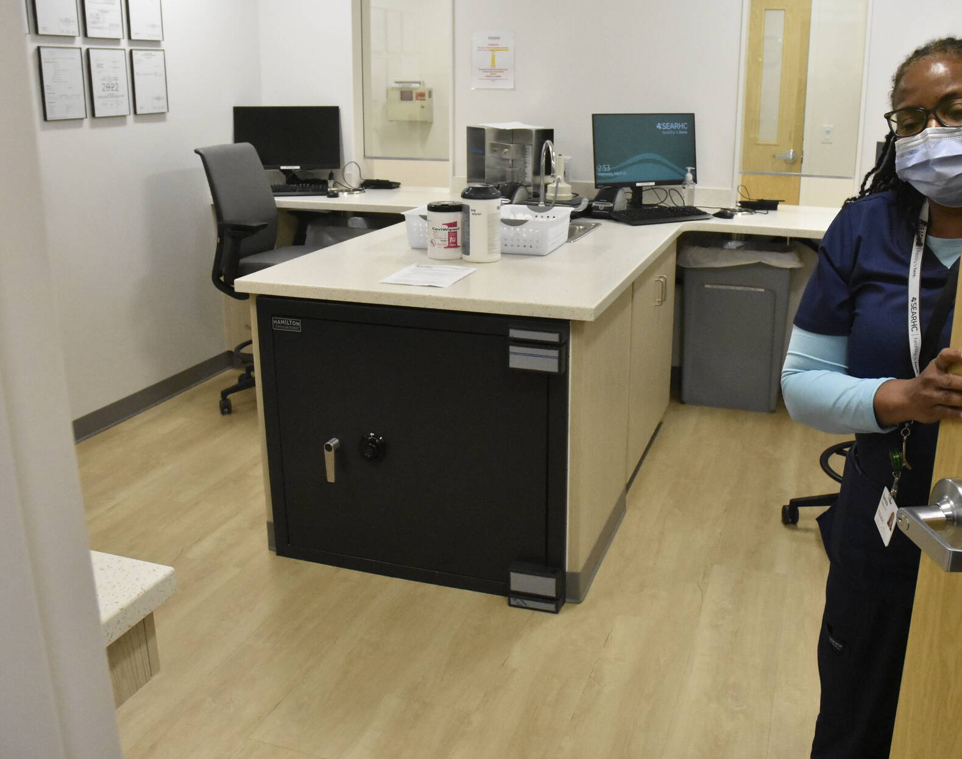
Recovery in Juneau
Tlingit and Haida Groups
Alcoholics Anonymous (AA), Narcotic Anonymous (NA), Alanon, Dual Recovery Anonymous (DUA)
Housing First
AWARE
Gastineau Human Services
Reentry Coalition
Polaris House
St. Vincent De Paul
Rainforest Recovery
Next Steps to Consider: What Recovery Services exists in Juneau? What is going great and could be made even better with more financial support? What is missing?

Slide 19
Guiding Principals for Use of Funds
John’s Hopkins Five Guiding Principals: (click to read more)
1) Spend the Money to Save Lives
2) Use Evidence to Guide Spending
3) Invest in Youth Prevention
4) Focus on Racial Equity
5) Develop a Fair and Transparent Process for Deciding Where to Spend the Funding
Alaska Governor’s Advisory Council on Opioid Remediation 2022 Recommendations (click here to read)
Consider sustainability, robust steering committee to draft funding announcements and review applications, community feedback, public reporting, data informed, evidence based and/or culturally relevant, population/public health framework.
Next Steps to Consider: What are Juneau’s guiding principals?

Slide 20
Next Steps
If desired, discuss opportunities for Engagement between City and Borough of Juneau and Community

